Slide 1

Patient Monitoring System
Team Leader: Robert Tosic
Client: Christopher Burger
Requirements Engineer: Ryan Randive
Developers: Andy Llactahuamani, Paul Martins
Tester: Zain Quraishi

Slide 2
Requirements Elicitation
As the Client, what did you require this program to do?
As the Requirements Engineer, how did you organize/categorize those requirements into the Requirements Document?

Slide 3
Software Architecture
As the Developers, how did you envision the architectural solution?
How do the requirements relate to your implementation?

Slide 4
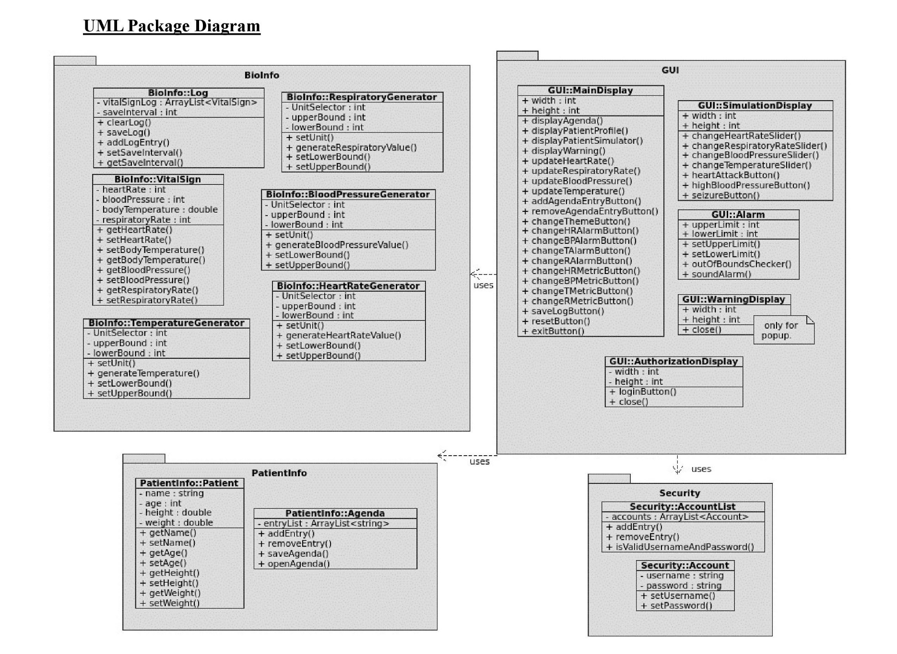

Slide 5
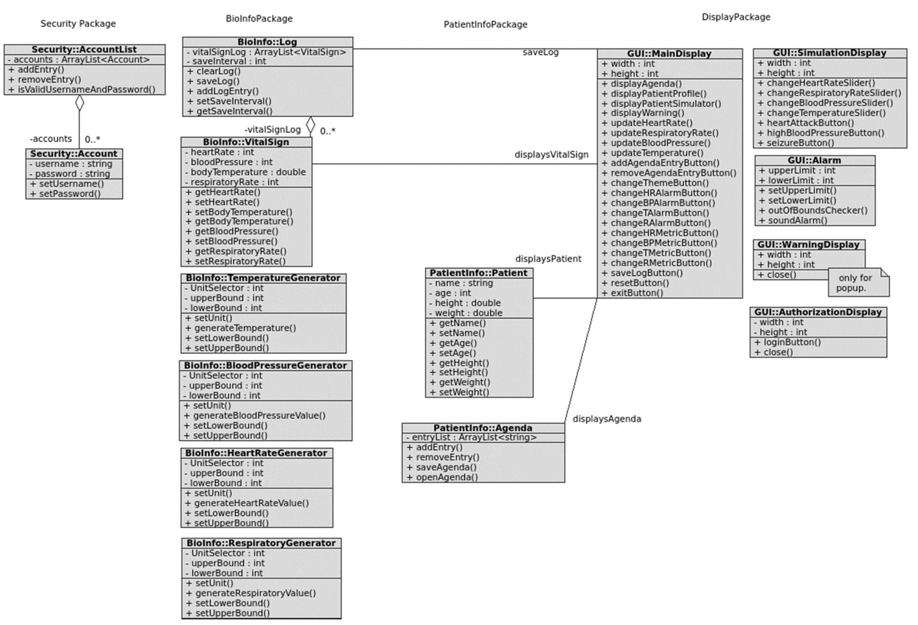

Slide 6
DEMO
Patient Monitoring System

Slide 7
Testing
Static Testing (done during design phase)
Software Quality Assurance: Verification and Validation (V&V)
Static Verification: Requirements (Functional/Non-Functional) sourcing/traceability
Validation: Did we build the right product?
Does the software meet the needs of the client/users?

Slide 8
Test cases
Dynamic Testing/Verification (done during implementation phase)
Example Test Cases:
UC #1-4: Display Vital Sign Data, The data placed on the graphs are realistic and reasonable values checking for any sporadic data points/anomalies.
UC #5: Access Patient's Medical History: Execute the ‘open file’ option in the menu to observe whether a certain patient’s file can be accessed and displayed through the program.
UC #6: User/Client Verification, Entering numerous iterations and combinations of usernames and passwords to evaluate the robustness of the welcome/login system.
UC #8: Display Agenda, Iteratively adding multiple events to inspect overflow handling, and removing events to verify the functionality of the use case.

Slide 9
Test Cases Cont’d
UC #9: Log Patient's Medical Data, inspecting the corresponding values for each Vital Sign in the log and application, also verify the patient’s information and events have been properly recorded and logged.
UC #10: Display Warnings/Alerts, Exhaustively testing the simulation controls by checking the validity of the effects of the simulations (if any), and carefully observing how the program responds.
UC #11: System Start-up and Re-Initialization Sequence, Check performance of program and data repos by evaluating response time to inputs (start-up, changing values, patient information), and by inspecting how the program handles a re-initialization sequence with the previous patients data.
UC #12: Modifying Patient Warning/Alarm Thresholds, by iteration; modifying the threshold values and observing if the program adequately adapts the new thresholds and displays warnings if the new thresholds have been exceeded.

Slide 10
FIN

